Slide 1

nRF52840 Introduction
Introduction to the nRF52832 System-on-chip(SoC) and the nRF52 Development Kit
Edvin Holmseth
Uni. Of Strathclyde
January 2020

Slide 2
nRF52 System-on-Chip(SoC) Architecture
ARM Cortex-M4F Processor
Internal Flash
Multi-Segmented RAM
Flexible GPIO Mapping
PPI - Task and Event System
Embedded Flash
w/ Cache
RAM
AHB
Power Management
ARM®
Cortex-M4F
VDD
Analog
I/F
System Peripherals
APB/EasyDMA/PPI
GPIO
Digital
I/F
Pin Crossbar
2.4GHz Radio
w/ Balun
BLE
ANT
2.4GHz
13MHz
ANT
NFC
Oscillators
32kHz
XTAL (opt.)
32 MHz XTAL
Notes:
nRF52 Architecturally similar to nRF51 series so very familiar. Similar architectures but a massive move forward in terms of performance and features.
Cortex-MF processor with very good Coremark stats both Coremark/MHz and more importantly Coremark/mA. Importantly it is an M4 with DSP instruction set and a Floating Point unit (FPU) hence the ‘F’. #2-bit AHB bus has been expanded to allow more simultaneous communication between peripherals. All peripherals also have their own EasyDMA now enabling much more autonomous operation between peripherals compared to nRF51. RAM is selectable in 4KB blocks as needed to reduce power consumption. PPI task & events still there for peripherals. Fully flexible GPIO for optimal routing of peripherals to IO pins and integrated RF Balun for most efficient PCB layout routing
2 crystal

Slide 3
nRF52840 Overview
Digital Interfaces | 4x SPI Master or Slave 2x TWI Master or Slave 2x UART 4x PWM QDEC PDM I2S NFC USB
Analog interfaces | 8-channel 10/12-bit ADC 15-level LP Comparator 64-level GP Comparator
GPIO | 48 pins
System peripherals | 5 x 32-bit Timers (2 with 6 CC Regs) 3 x Real-Time Counters(RTC) Programmable Peripheral Interconnect(PPI)
Radio | BLE / ANT / 2.4 GHz / IEEE 802.15.4 2 Mbps / Long Range +8 dBm
Processor | Cortex M4F 64 MHz
Memory | 1024 kB Flash w/cache 256 kB RAM with EasyDMA
Power management | 1.7 to 5.5V supply voltage LDO and Buck DC/DC

Slide 4
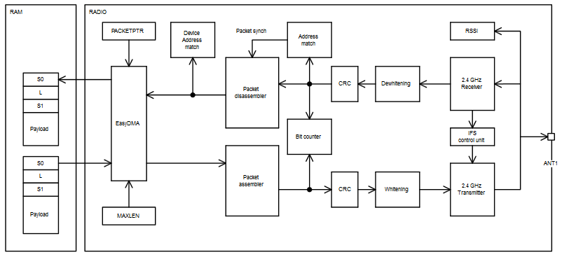

Powerful Ultra-Low Power Radio
Multi-Protocol Support | Bluetooth 5 ANT 2.4GHz RF IEEE 802.15.4
Performance (1MBps BLE) | - 96 dB RX Sensitivity Up to +4 dBm TX output Power
Power Efficiency (3V, DC/DC On) | 5.4 mA RX Active Current 5.3 mA TX Active Current at 0 dBm 7.5 mA TX Active Current at +4 dBm
Features | EasyDMA / Register Interface / Soft FIFO in RAM RSSI On-chip Balun, Single ended RF pin
Notes:
The main purpose data whitening(scrambling) is to remove the long strings of ones or zeroes which may exist in the raw input data. The alternation of symbols is required for normal operation of the bit synchronization in receiver.

Slide 5
Flexible GPIO mapping
Configurable I/O - Pin Mapping
Dynamic Mapping with Software
Most Pins Support Analog and Digital
Simplifies PCB Design
Enabling lower Cost PCB
Enabling more Compact Layout
Analog I/O
Digital I/O
Pin Crossbar
Pins
NFC
Configure
Processor

Slide 6

NFC Tag
Software Stack | Card Emulation NFC-A Type 2 and Type 4 Read and write Support for Bluetooth low energy Touch-to-Pair
Current Consumption | 400uA in Active Mode 100nA in Wake on Field Mode
Supported Antennas | NFC Forum Listener 6 (25x20mm 4-turn PCB antenna) Abracom 32 x 25mm flex Antenna
Range | Up to 40mm (depending on antenna and field strength)

Slide 7
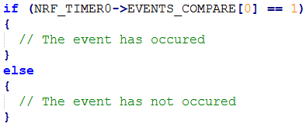
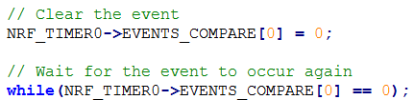
Peripheral Tasks and Events
Peripheral
Events
Event Register

Slide 8
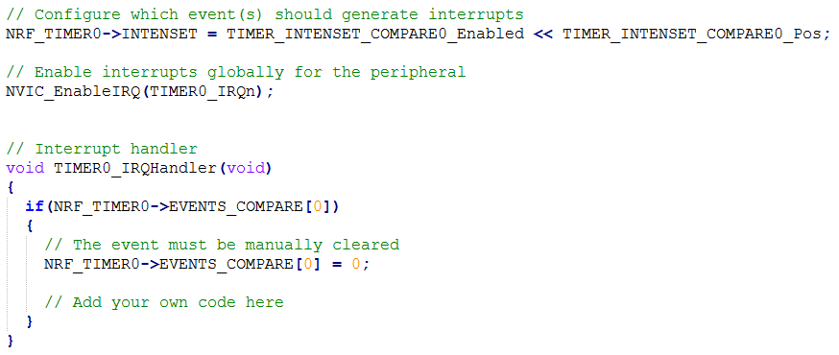
Peripheral Tasks and Events
Peripheral
Events
Event Register
Interrupt Handler
INTEN Register

Slide 9
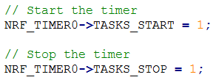
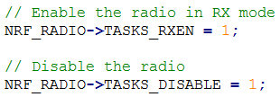
Peripheral Tasks and Events
Peripheral
Event Register
Interrupt Handler
INTEN Register
Task
Task Register

Slide 10
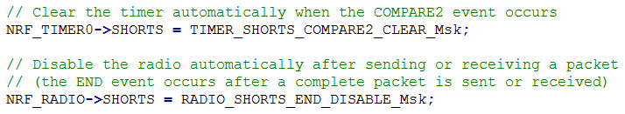
Peripheral Tasks and Events
Peripheral
Events
Event Register
Interrupt Handler
INTEN Register
SHORTS Register
Task
Task Register

Slide 11


Two Global Power Modes
ON
OFF
All blocks Idle and ready to start
Configurable RAM retention
All wake-up sources
Clock and power management running
All blocks turned Off
Configurable RAM retention
Wake-on Reset, Pin, Comparator and NFC
I/O pin state retained
3.7
mA
1.2
uA
300
nA
CPU Running
ON Idle with RTC
OFF

Slide 12
Power Management
System Off
System On
AHB-Lite
ARM Cortex M4
RAM
SWDIO
SWCLK
Debugger
Program memory
WDT
NFC
NVMC
P0.0-31
GPIO
Radio
ANT1
ANT2
LPCMP
Timer
P0.0-31
GPIOTE
RTC
SCK
SPI
ECB
MISO
MOSI
Notes:
WUCMP

Slide 13
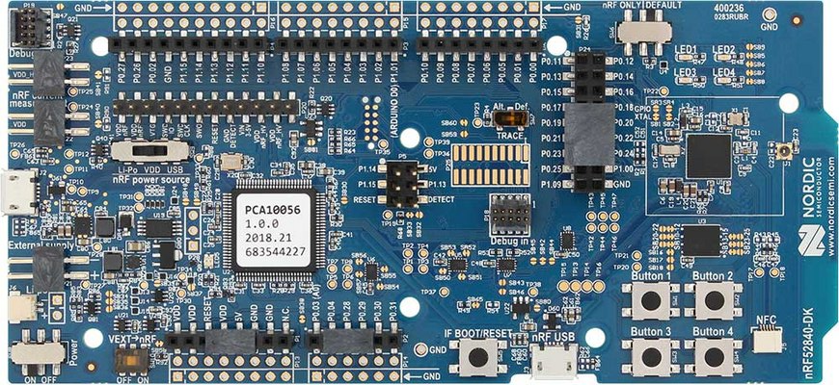
nRF52840 Development Kit
Key Features
nRF52840 SoC
Notes:
Modifications:
100% bullet size
Centred
Issues

Slide 14
nRF52840 Development Kit
Key Features
nRF52840 SoC
Buttons and LEDs for user interaction
Notes:
Modifications:
100% bullet size
Centred
Issues

Slide 15
nRF52840 Development Kit
Key Features
nRF52840 SoC
Buttons and LEDs for user interaction
I/O interface for Arduino form factor plug-in modules
Notes:
Modifications:
100% bullet size
Centred
Issues

Slide 16
nRF52840 Development Kit
Key Features
nRF52840 SoC
Buttons and LEDs for user interaction
I/O interface for Arduino form factor plug-in modules
Segger J-link OB Debugger with debug out functionality
Notes:
Modifications:
100% bullet size
Centred
Issues

Slide 17
nRF52840 Development Kit
Key Features
nRF52840 SoC
Buttons and LEDs for user interaction
I/O interface for Arduino form factor plug-in modules
Segger J-link OB Debugger with debug out functionality
Virtual COM Port interface via UART
Drag-and-drop Mass Storage Device programming
Notes:
Modifications:
100% bullet size
Centred
Issues

Slide 18
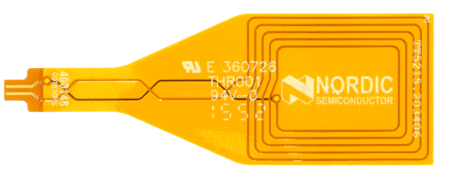
nRF52840 Development Kit
Key Features
nRF52840 SoC
Buttons and LEDs for user interaction
I/O interface for Arduino form factor plug-in modules
Segger J-link OB Debugger with debug out functionality
Virtual COM Port interface via UART
Drag-and-drop Mass Storage Device programming
NFC-A Support
Notes:
Modifications:
100% bullet size
Centred
Issues

Slide 19
nRF52840 Development Kit
SDK examples are tailored to our Development Kits
UART or Segger Real-Time Terminal (RTT) allows for easy debugging
Measure the current consumption of your application
Notes:
Modifications:
100% bullet size
Centred
Issues

Slide 20
nRF52840 Introduction
Edvin Holmseth
NTNU Gløshaugen
November 2019

Slide 21
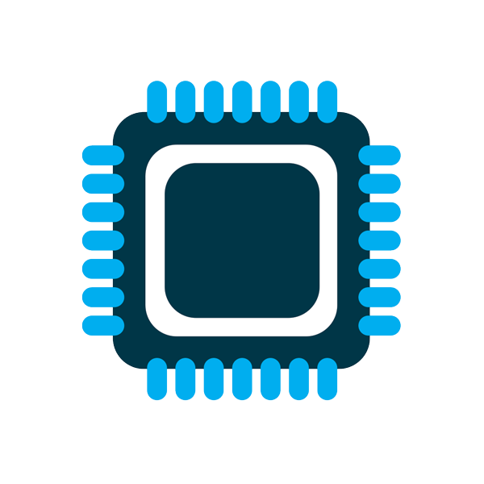
Microcontroller Introduction
A short introduction to the wonderful world of microcontrollers!
Bjørn Spockeli
NTNU
October 2018

Slide 22
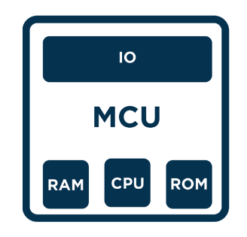
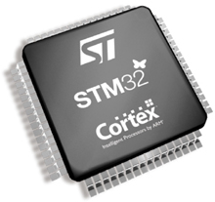
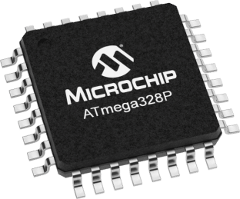
What is a microcontroller?
“A microcontroller is a self-contained system with peripherals, memory and a processor that can be used as an embedded system.”
Comes in many shapes and sizes
8-bit, e.g. AVR 328P
32-bit, e.g. STM32 (ARM Cortex M3)
Notes:
A microcontroller is a self-contained system with peripherals, memory and a processor that can be used as an embedded system. Most programmable microcontrollers that are used today are embedded in other consumer products or machinery including phones, peripherals, automobiles and household appliances for computer systems. Due to that, another name for a microcontroller is "embedded controller." Some embedded systems are more sophisticated, while others have minimal requirements for memory and programming length and a low software complexity. Input and output devices include solenoids, LCD displays, relays, switches and sensors for data like humidity, temperature or light level, amongst others.

Slide 23
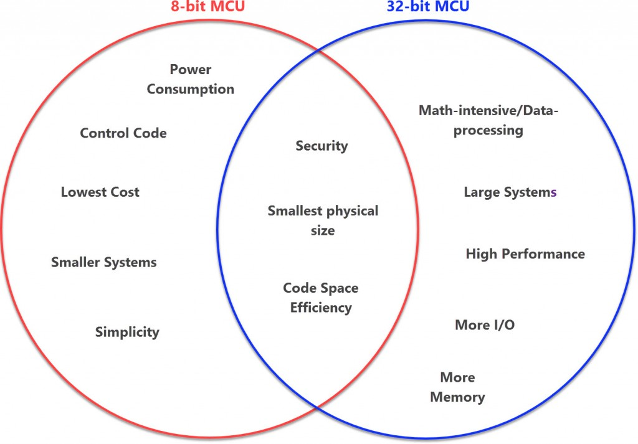
8-bit vs 32-bit?

Slide 24
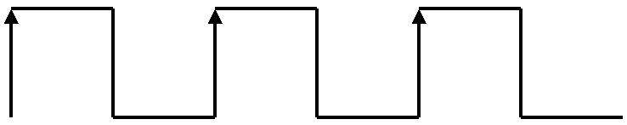
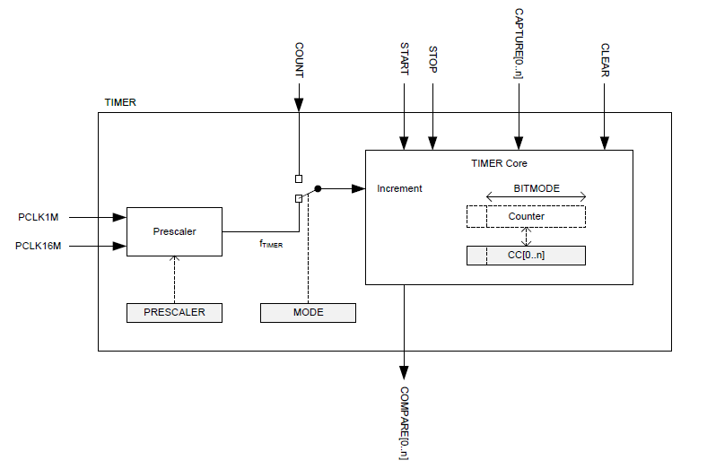
Timers/Counters
Counts the clock cycles of the system clock
Comes in 8-bit, 16-bit, 24-bit or 32-bit configurations(usually configurable)
COUNTER register keeps track of the number of clock cycles
Compares Counter with Capture/Compare(CC) registers.
Prescaler determine how often the Counter is updated, e.g prescaler of 8 will result in the counter incrementing every 8th clock cycle
Notes:
Most uC has a configurable prescalerwhich determines how often the COUNTER register value is incremented.

Slide 25
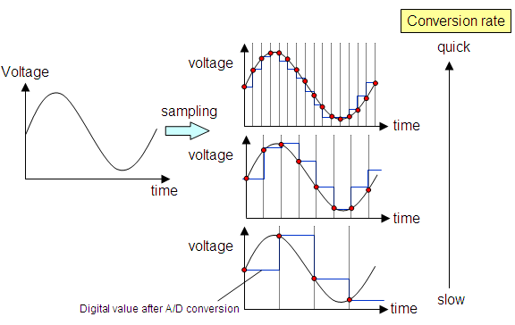
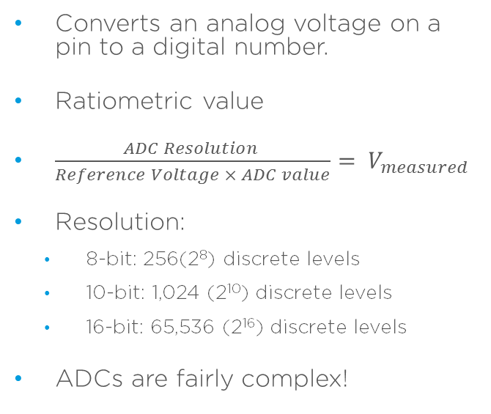
Analog-Digital Converter(ADC)
Converts an analog voltage on a pin to a digital number.
Ratiometric value
$\frac{ADC Resolution }{Reference Voltage × ADC value}= V_{measured}$
Resolution:
8-bit: 256(2⁸) discrete levels
10-bit: 1,024 (2¹⁰) discrete levels
16-bit: 65,536 (2¹⁶) discrete levels
ADCs are fairly complex!
Notes:
ADC res = 10 bit , ref. Voltage = 5.0v and the Vmeas = 2.12V

Slide 26
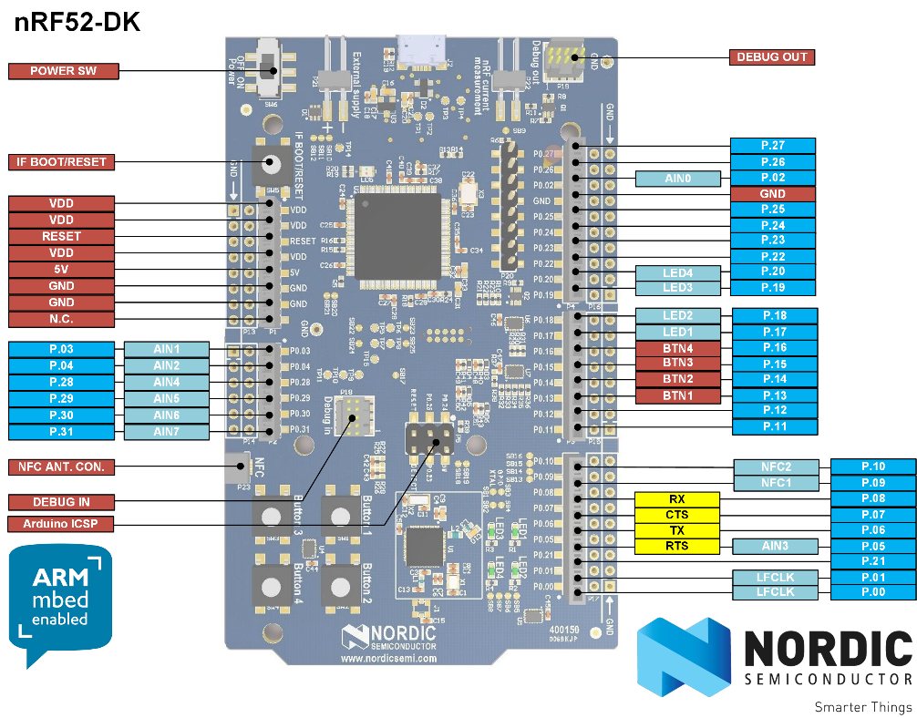
General Purpose Input/Output(GPIO) pins
Generic pin controllable by the user at run time.
Arranged in ports, pins per port is determined by architechture, e.g. 32-bit -> 32 pins/port
Configurable parameters:
Input/Output
Digital/Analog
Internal pull-up and/or pull-down resistor
Drive strength

Slide 27
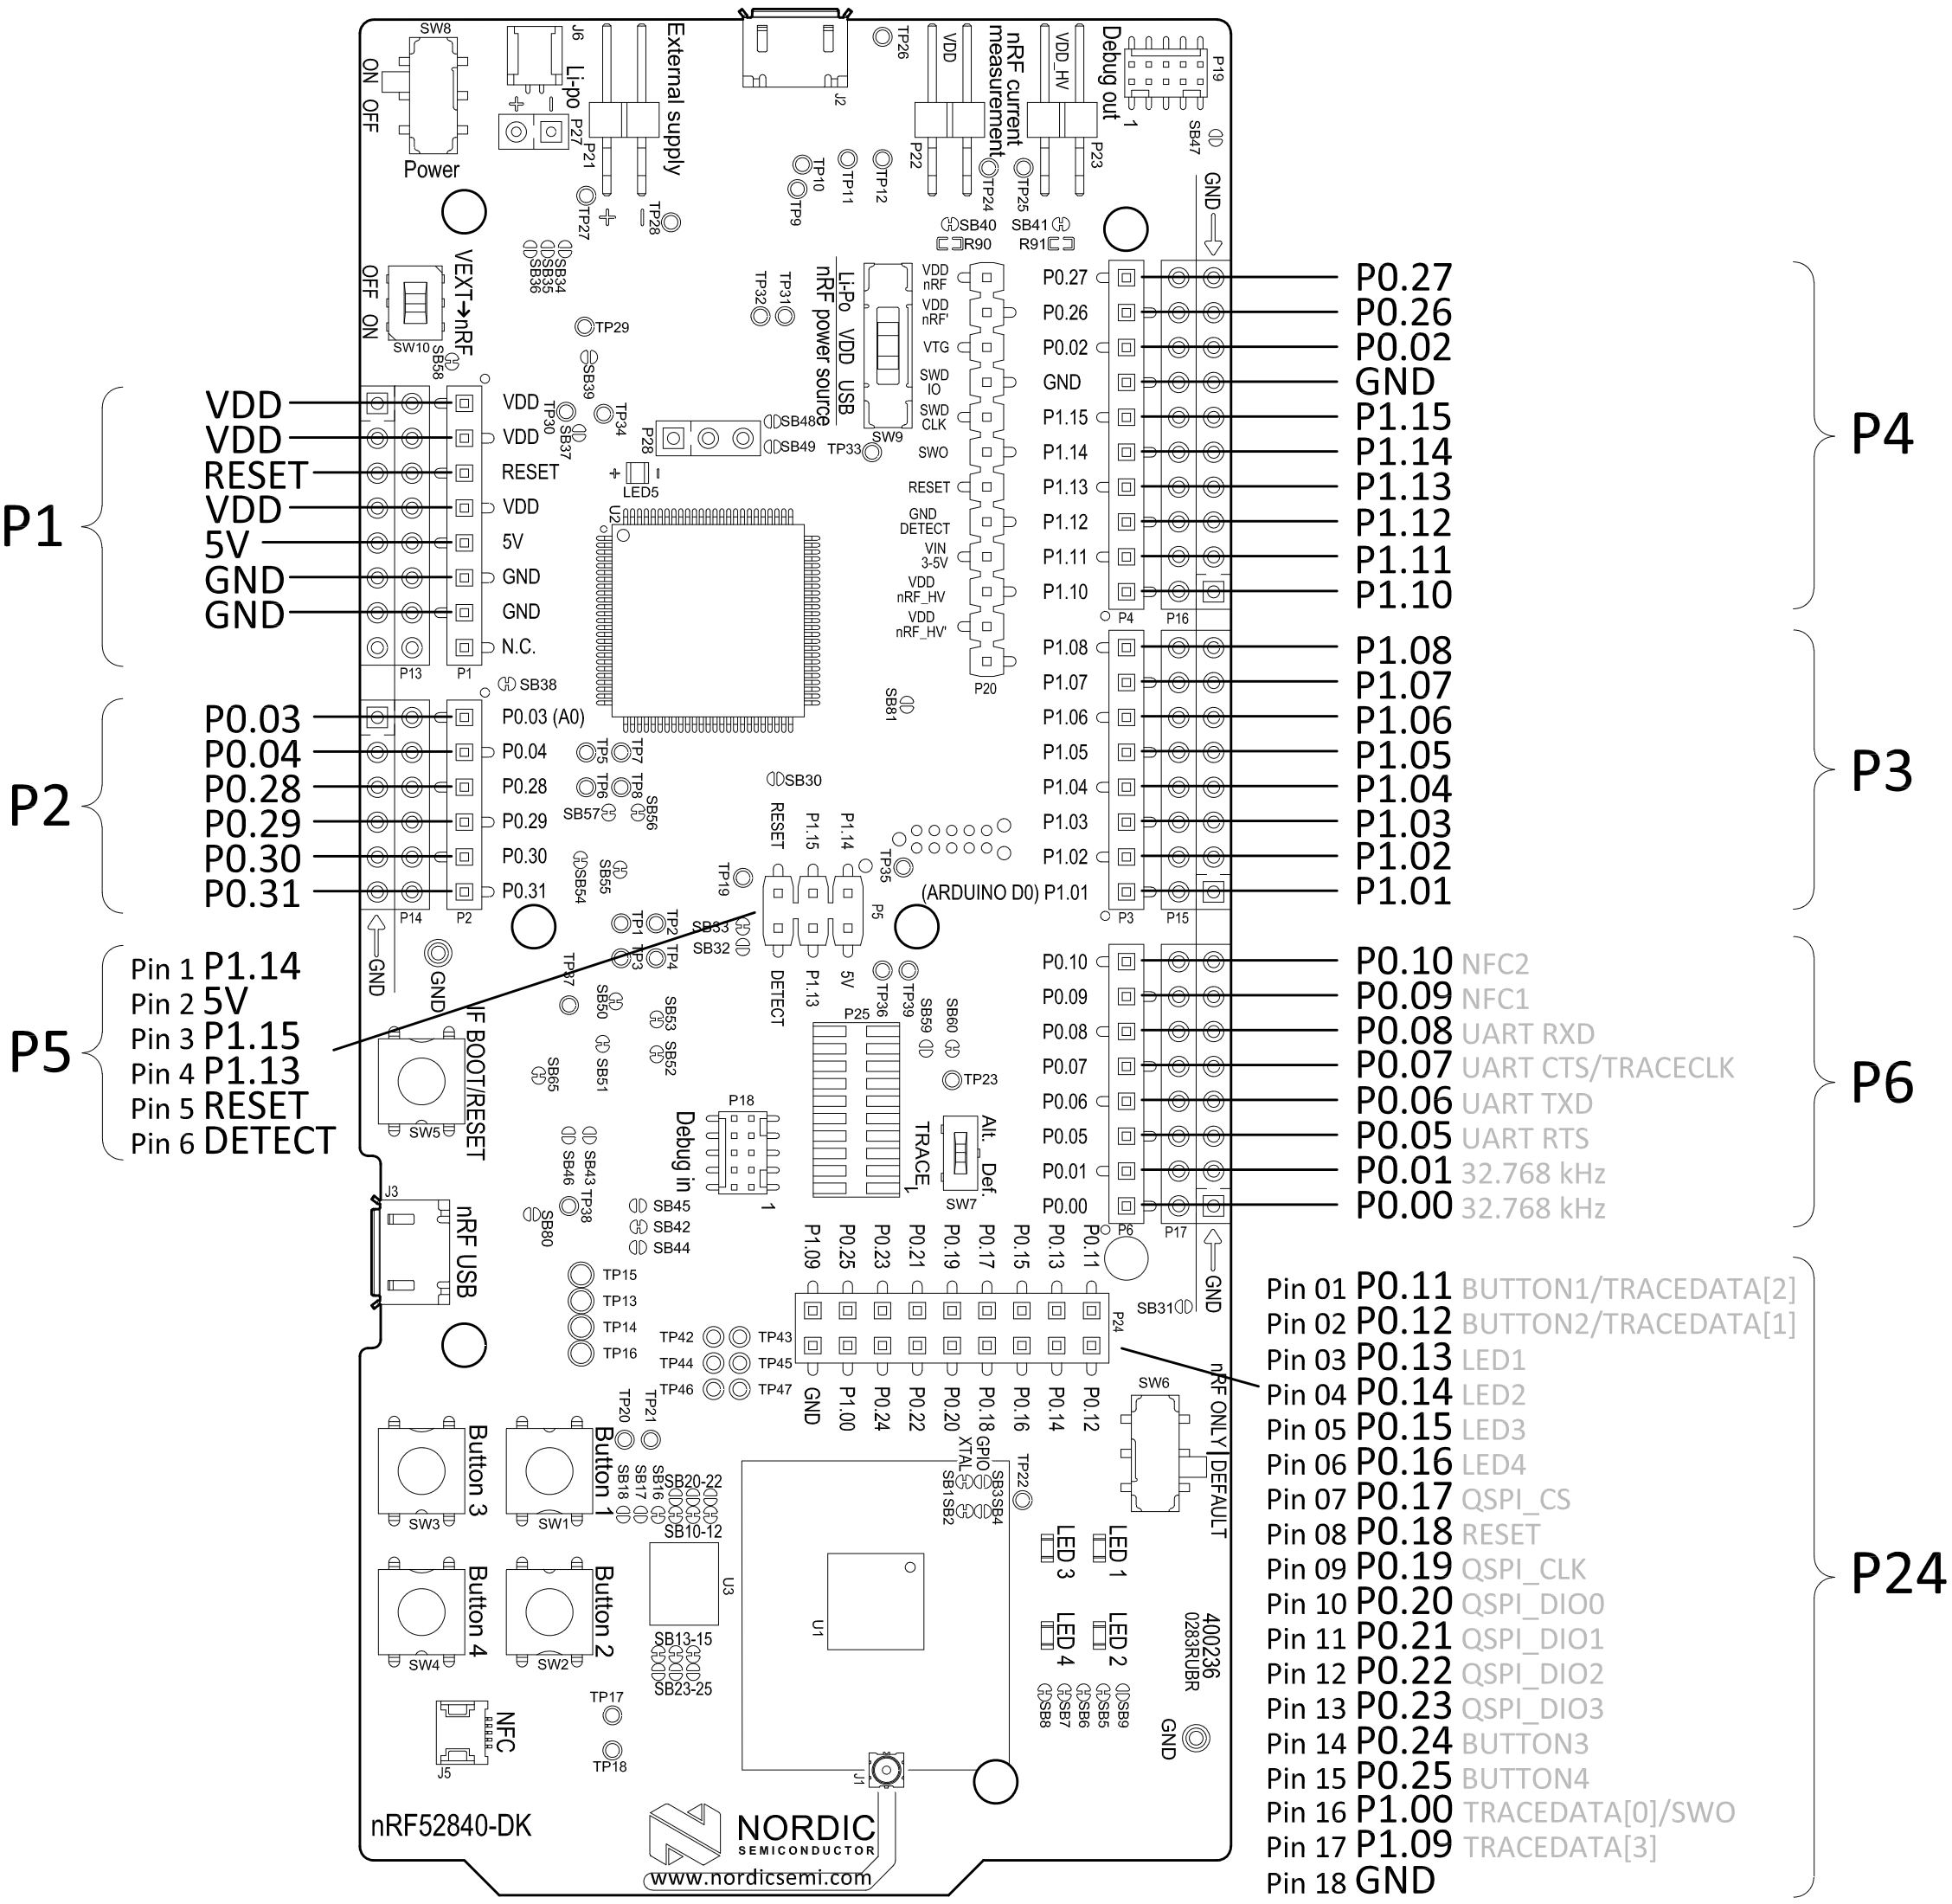
General Purpose Input/Output(GPIO) pins
Generic pin controllable by the user at run time.
Arranged in ports, pins per port is determined by architechture, e.g. 32-bit -> 32 pins/port
Configurable parameters:
Input/Output
Digital/Analog
Internal pull-up and/or pull-down resistor
Drive strength

Slide 28
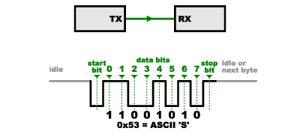
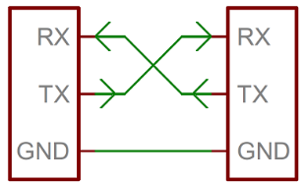
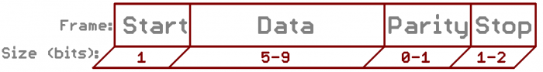
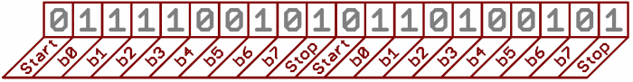
Serial Communication Universal asynchrounous receiver/transmitter(UART)
Asynchronous = data is transfer without no clock signal.
Can be simplex(1 line), half-duplex(1/2 lines) or full-duplex(2 lines)
Data needs to be framed:
Data bits: Data that you want to sent
Synchronization bits: Start and stop bits
Parity bits: Used for error checking
Both sides must agree Baudrate: Transfer speed

Slide 29
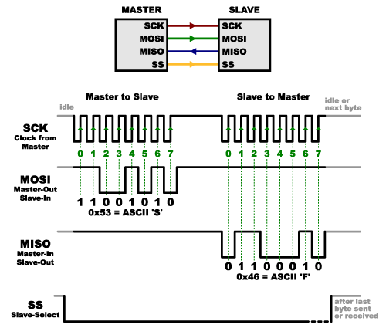
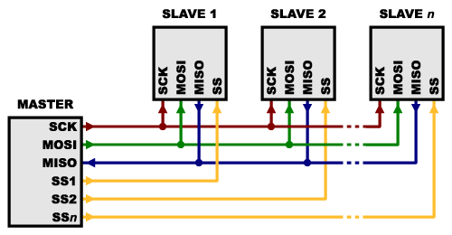
Serial Communication Serial Peripheral Interface(SPI)
Synchronous data transfer = clock signal
Uses four lines
SCK – Clock signal
MOSI(Master-Output, Slave-Input)
MISO(Master-Input, Slave-Output)
SS – Slave Select
Advantages
Full-duplex
Support clock rates upwards of 10MHz
Supports multiple slaves
Disadvantages
Uses minimum 4 lines.
Each slave needs a separate SS line
Notes:
full-duplex (simultaneous sending and receiving of data)

Slide 30
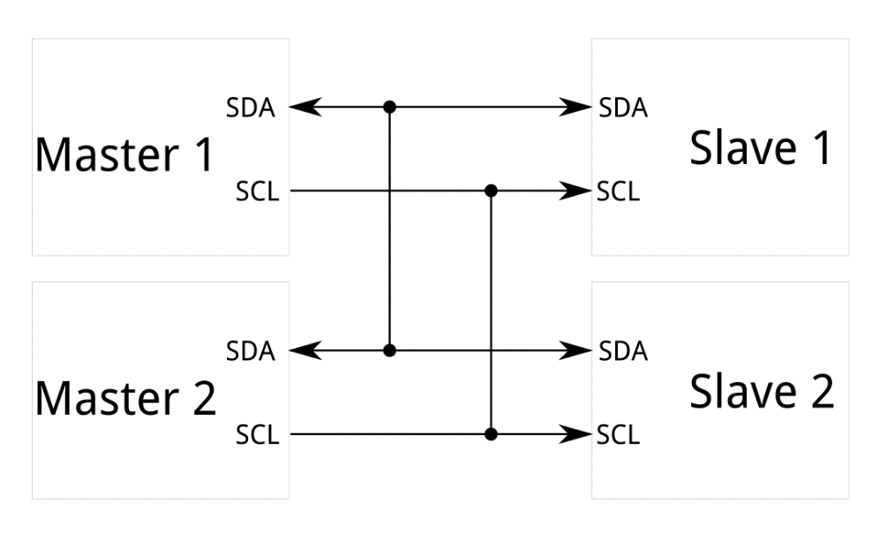
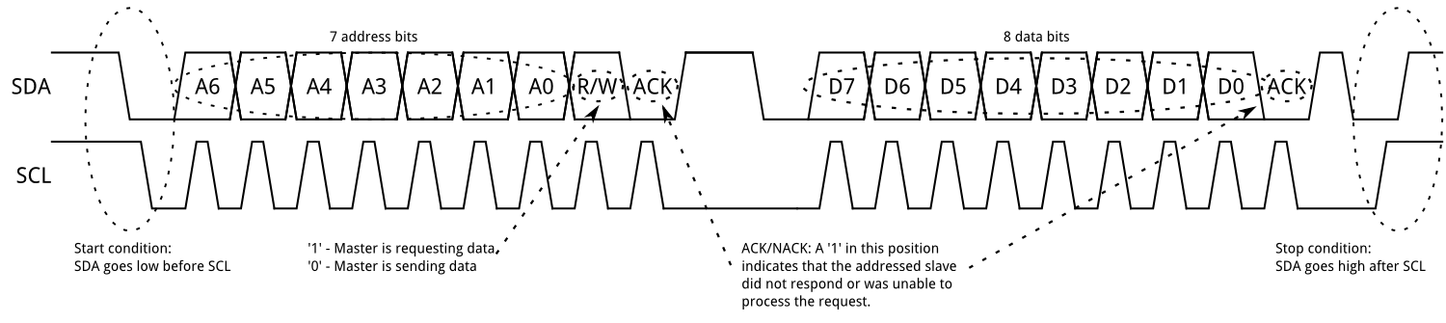
Serial Communication Inter-integrated Circuit(I²C)
I2C bus consists of two signals:
SCL is the clock signal
SDA is the data signal
Half-duplex
Clock speed at 100kHz or 400kHz
Notes:
I²C was originally developed in 1982 by Philips for various Philips chips. The original spec allowed for only 100kHz communications, and provided only for 7-bit addresses, limiting the number of devices on the bus to 112 (there are several reserved addresses, which will never be used for valid I²C addresses). In 1992, the first public specification was published, adding a 400kHz fast-mode as well as an expanded 10-bit address space. Much of the time (for instance, in the ATMega328 device on many Arduino-compatible boards) , device support for I²C ends at this point. There are three additional modes specified: fast-mode plus, at 1MHz; high-speed mode, at 3.4MHz; and ultra-fast mode, at 5MHz.

Slide 31
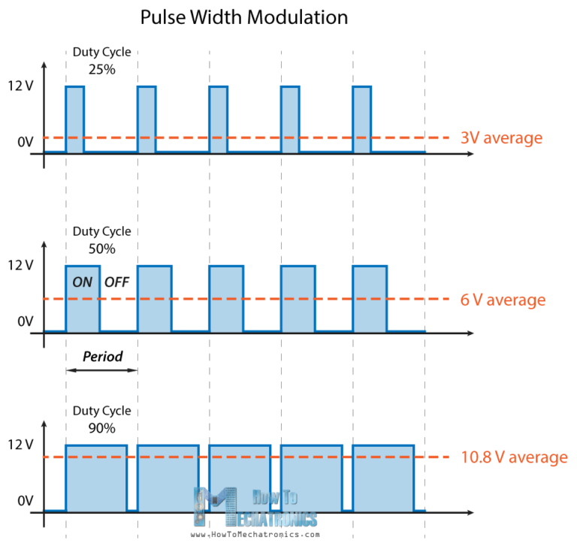
Pulse-Width Modulation(PWM)
A method for generating an analog signal using a digital source.
A digital signal is either High or Low, cannot be something in-between.
A PWM signal is defined by its:
Frequency(Hz)
Duty cycle(percentage)
Notes:
The duty cycle describes the amount of time the signal is in a high (on) state as a percentage of the total time of it takes to complete one cycle. The frequency determines how fast the PWM completes a cycle (i.e. 1000 Hz would be 1000 cycles per second), and therefore how fast it switches between high and low states.
Usage:
Control the brightness of LED
Control the speed of a DC motor
Control the angle of a servo

Slide 32
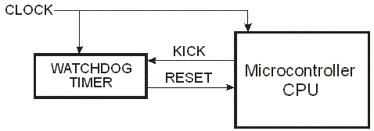
Watchdog Timer(WDT)
Failsafe mechanism
Counter starting at a predetermined value and counts down to zero.
System will be reset if the watchdog counter reach zero.
CPU must «feed» or «kick» the Watchdog to reset the counter.

Slide 33

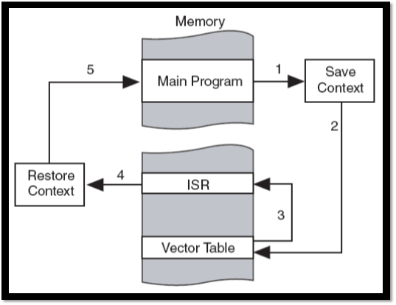
Polling and Interrupts
Polling: CPU continously monitors a variable/register to see if a specific task should be performed.
Interrupt: CPU is free to execute its main code until an interrupt occurs, it will then branch to the Interrupt Service Routine or Interrupt Handler which contains code to do the task.
Interrupts are more efficient than polling. (Mailbox anology)

Slide 34
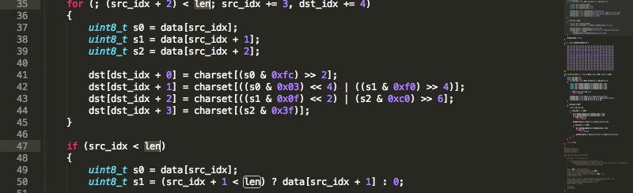
Embedded C programming
Short introduction to C programming on embedded devices

Slide 35
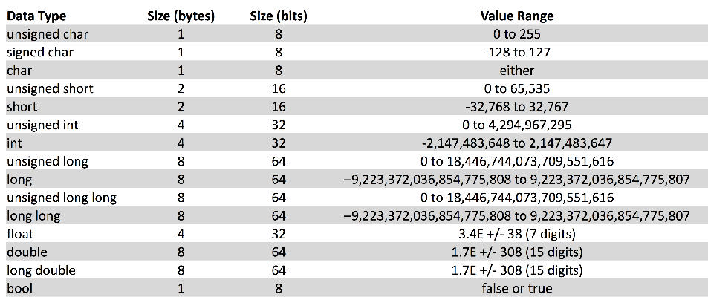
Data types

Slide 36
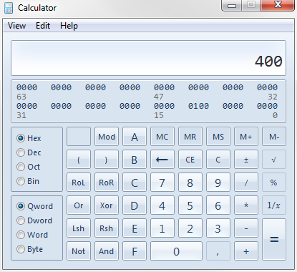
Binary & Hexadecimal
Binary is base 2
Uses only 0 and 1
Hexadecimal is base 16
Uses digits 0-9 and letters A-F
4 binary digits can be represented by 1 hexadeximal digit. (16 = 2⁴ )
Numbers take up less space and are easier to write. Ex. 10 = 0b1010 = 0xA

Slide 37

Endianess
Byte/bit order.
Big endian: most significant bits (MSBs)occupy the lower address.
Little endian: least significant bits (LSBs) occupy the lower address.
nRF52840 uses Little Endian.

Slide 38
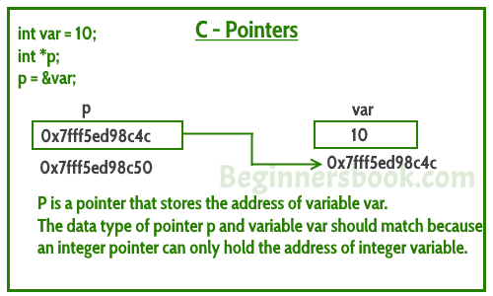
Pointers
A pointer points to the memory address of a variable.
The pointer itself has an memory address.
The pointer can be dereferenced to access the value at the memory address.
* is called the dereference operator
& is the reference operator.

Slide 39
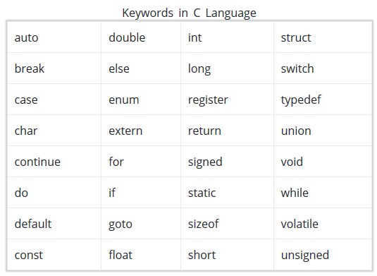
Keywords
Keywords are predefined, reserved words that have special meanings to the C compiler.
40 keywords in C, we’ll concentrate on:
typedef
const
static
struct
void
Assume that if, else, for and while are known.

Slide 40
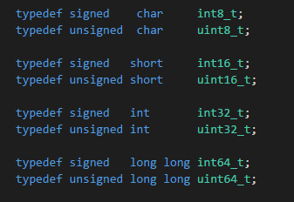
Keywords - typedef
The typedef keyword is used to explicitly associate a type with an identifier.
More convenient to write int8_t than signed char
Make the code more readable and understandable.

Slide 41
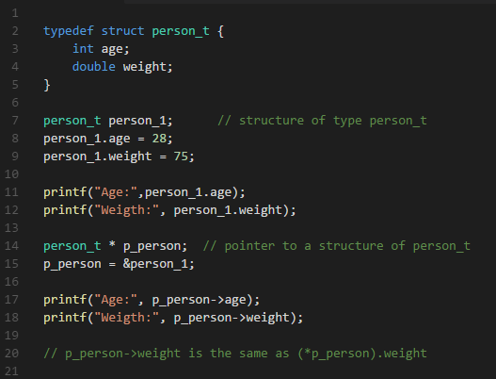
Keywords - struct
The struct keyword is used for declaring a structure(often used in combination with typedef).
A structure can hold member variables of different types under a single name.
The . (dot) operator is used to access member variables
The -> operator is used to access member variables from a structure pointer.

Slide 42
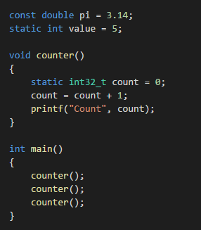
Keywords – const and static
A constant is a value or an identifier whose value cannot be altered in a program.
static has two different meanings:
A static global variable/function or a function is "seen" only in the file it's declared in.
A static variable inside a function keeps its value between function calls.

Slide 43
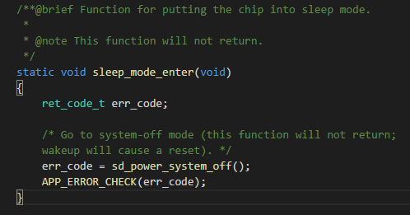
Keywords - void
The void keyword indicates that a function doesn't return any value.
The void keyword can also be passed as an argument to a function, indicating that this function has no parameters

Slide 44
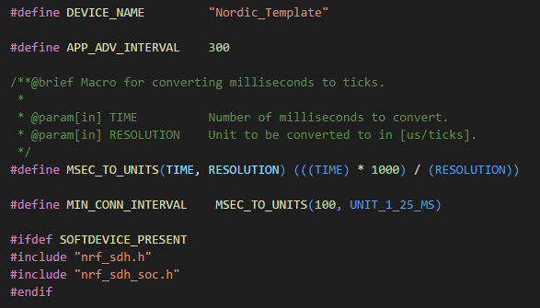
Macros and Conditional directives
A macro is a fragment of code which has been given a name. The name will be replaced by the code fragment.
Two types of macros
Object-like macros
Function-like macros
Conditional directives are used to decide which code chunks that should be compiled.
Notes:
Object-like: Most commonly used to give symbolic names to numeric constants

